Slide 1

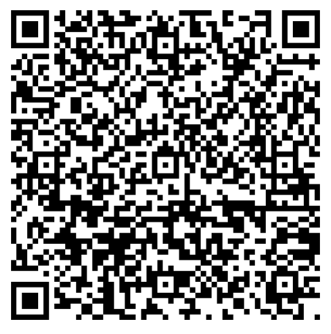
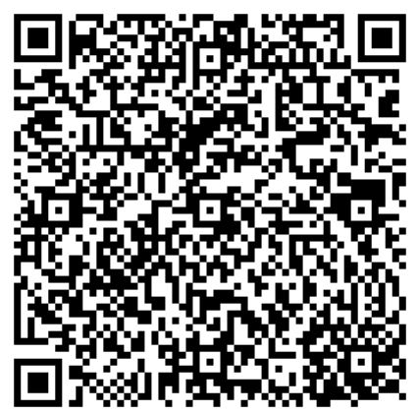
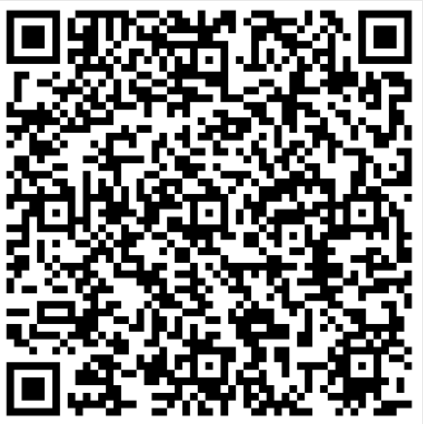
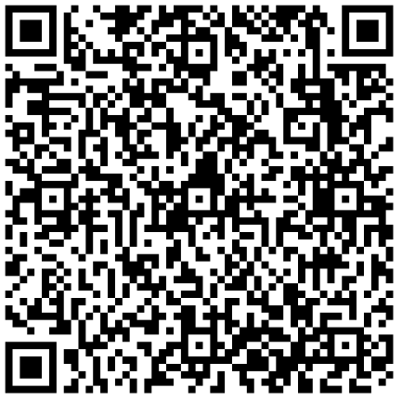
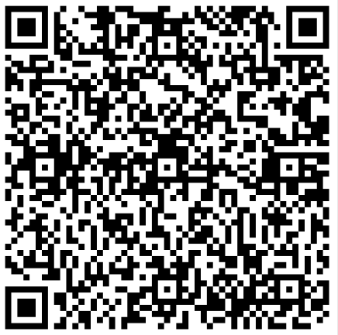

2026 Meridian Science Masterclasses
Supporting Year 11’s in the run up to February Mock
In need of some Science support?
Why not join us online with students across Meridian Trust!
You will need a device which runs Microsoft Teams
Register for the masterclasses using your school email address. Click on the links or scan the QR code and it will take you to the registration page!
Cameras and microphones will be disabled but you can ask as many questions as you want through the chat!.
4:00-4:30 we will cover Foundation and common tier concepts
4:30-5:00 we will cover Higher tier concepts
Date | Masterclass Theme | Registration link- must be logged into school email to register | QR CODE
3/11/2026 | Preparing for Paper 2 Chemistry (including required practicals) | https://events.teams.microsoft.com/event/bcefd4a8-ca8d-48d2-8e07-d3b5e534766a@e1d9b829-9816-4c54-9d9c-ade2d8e3aa6e
10/11/2026 | Preparing for Paper 2 Biology (including required practicals) | https://events.teams.microsoft.com/event/d722187b-716a-444e-9e69-d93980effc8e@e1d9b829-9816-4c54-9d9c-ade2d8e3aa6e
24/11/2026 | Preparing for Paper 2 Physics (including required practicals) | https://events.teams.microsoft.com/event/3124c30b-d5db-475e-beaf-4868e1372556@e1d9b829-9816-4c54-9d9c-ade2d8e3aa6e
1/12/2026 | Tackling challenging calculation questions in Physics paper 2 | https://events.teams.microsoft.com/event/7b9c3964-8730-42b2-928a-80986069952a@e1d9b829-9816-4c54-9d9c-ade2d8e3aa6e
8/12/2026 | Maths skills in Chemistry | https://events.teams.microsoft.com/event/bbf7dfff-c0f8-4375-bf49-237b6a6187b0@e1d9b829-9816-4c54-9d9c-ade2d8e3aa6e

